Slide 1
Day 12 ppt
Threads , process, operating system

Slide 2
What are pthreads
Posix 1003.1c defines a thread interface
pthreads
defines how threads should be created, managed, and destroyed
Unix provides a pthreads library
API to create and manage threads
you don't need to worry about the implementation details this is a good thing.

Slide 3
PROCESS
A program in execution
An instance of a program running on a computer (cooking vs. recipe)
The entity that can be assigned to and executed on a processor
A unit of activity characterized by the execution of a sequence of instructions, a current state, and an associated set of system resources

Slide 4
Requirement Of Operating System
Interleave the execution of multiple processes - multiprogramming -, to maximize processor utilization while providing reasonable response time
Allocate resources to processes
Support interprocess communication and user creation of processes

Slide 5
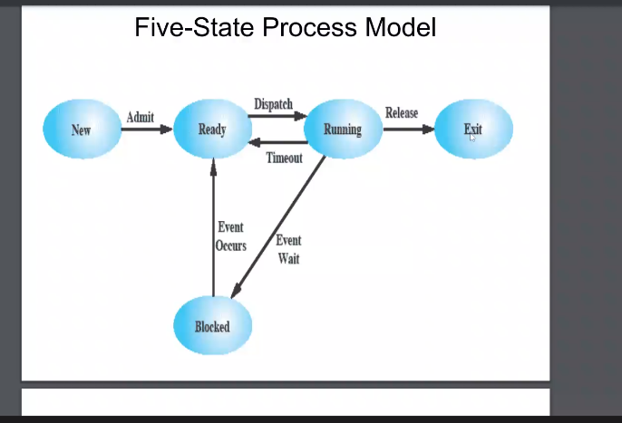
Five State Process Model

Slide 6
Process And Threads
Resource ownership - process includes a virtual address space to hold the process image
Scheduling/execution- follows an execution path that may be interleaved with other processes
These two characteristics are treated independently by the operating system

Slide 7
Threads
Process =
resource grouping (code, data, open files, etc.) +
execution (program counter, registers, stack)
Multithreading:
multiple execution takes place in the same process environment
co-operation by sharing resources (address space, open files, etc.)

Slide 8
Benefits Of Threads
Takes less time to create a new thread than a process
Less time to terminate a thread than a process
Less time to switch between two threads within the same process
Since threads within the same process share memory and files, they can communicate with each other without invoking the kernel

Slide 9
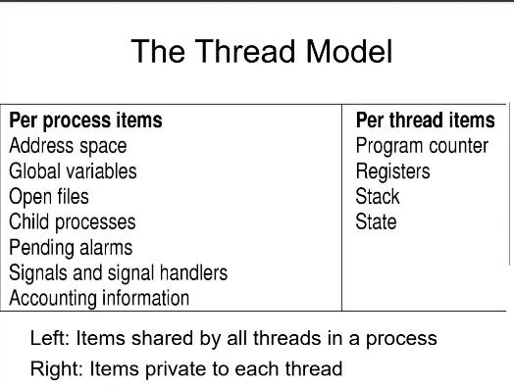
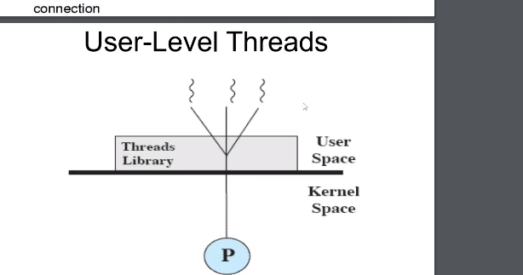
Thread Model

Slide 10
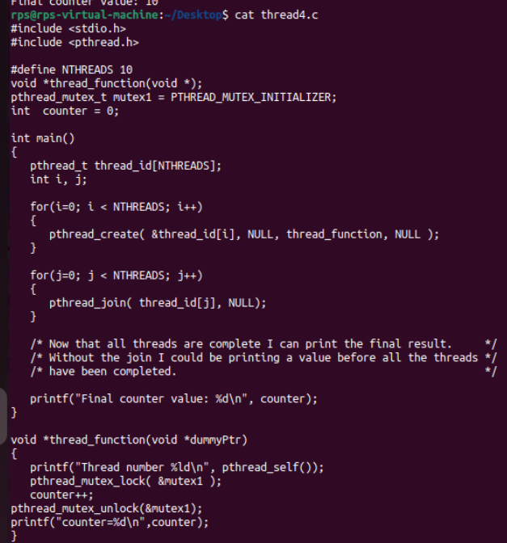
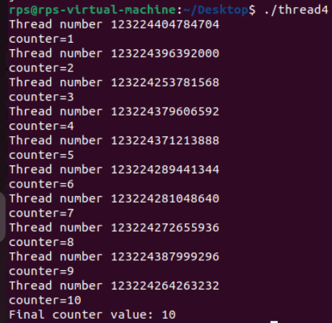
Thread Program

